Slide 1
What are Isotopes?

Slide 2
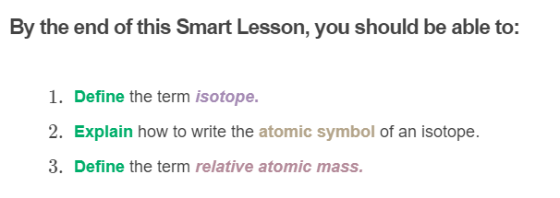
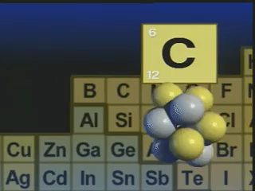

Slide 3
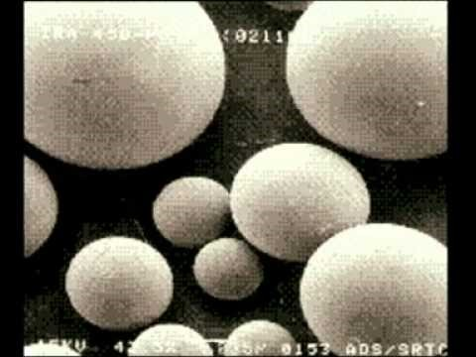

Slide 4
Isotopes are atoms of the same element that have different numbers of neutrons, but the same number of protons and electrons.

Slide 5
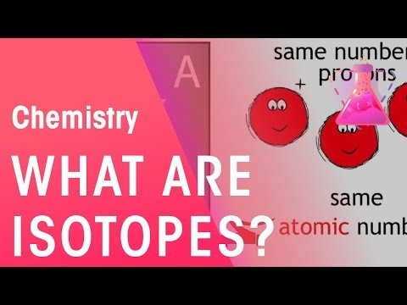

Slide 6
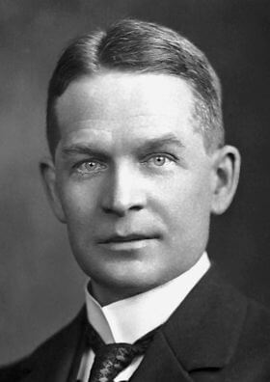
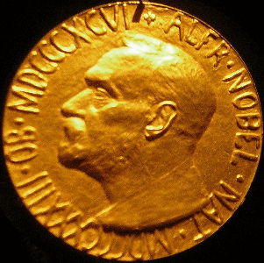
The concept of isotopes has been around for more than 100 years!
The existence of isotopes was first proposed by Frederick Soddy in 1913. Soddy was a British chemist who worked with Ernest Rutherford to study radioactive elements. He received a Nobel Prize in 1921 for his theory of isotopes.

Slide 7
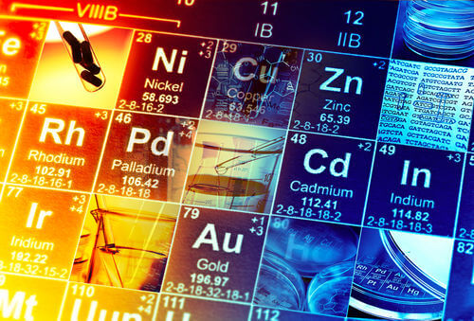
Soddy's experiments showed that atoms of the same element could have different atomic masses but identical chemical properties.
He named this concept an isotope, which means same place, because these atoms were found in the same place on the periodic table.
At the time, scientists could not come up with a good explanation for how this occurred.

Slide 8
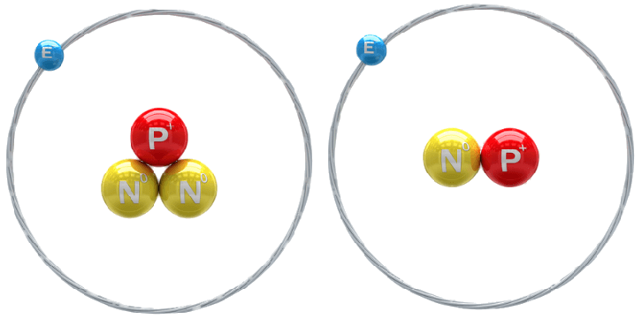
When neutrons were discovered in 1932, the problem was solved!
Atoms with the same number of protons had different masses because they had different numbers of neutrons. These atoms have the same properties because neutrons do not affect the chemical properties of elements.

Slide 9
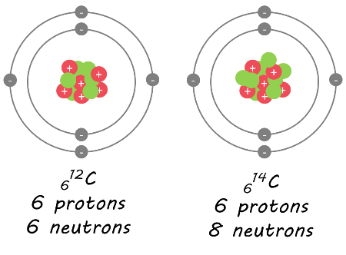
Isotopes are named based on their mass number.
The element's name is written first, followed by the mass number.
For example, these are two carbon isotopes. The first one has a mass number of 12, so is called carbon-12. The second one has a mass number of 14, so is called carbon-14.

Slide 10

Isotopes are often represented using atomic symbols.
The atomic symbol shows the chemical symbol of the element, with the mass number and atomic number written to the left. For example, carbon-12 is written like this:
The mass number is the larger number (number of protons plus neutrons) and this is written at the top. The atomic number is the smaller number (number of protons) and this is written at the bottom.

Slide 11
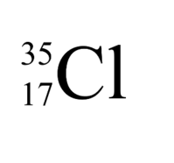
If you are given an atomic symbol, you can figure out the name of the isotope.
Isotope names are based on their mass number. Therefore, you just read the element's name and its mass number.
For example, what is the name of this isotope?
The mass number is 35, so this isotope is called chlorine-35.

Slide 12
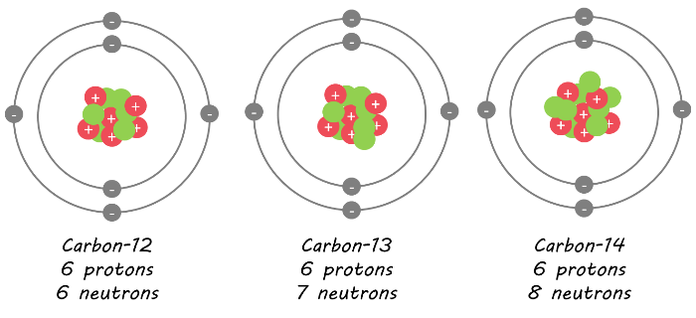
Different isotopes of elements are found in different amounts in nature.
This often depends on how stable the isotope is. For example, carbon-12 is the most stable isotope of carbon, while carbon-14 is unstable. This means that in nature, there is much more carbon-12 than carbon-14.

Slide 13
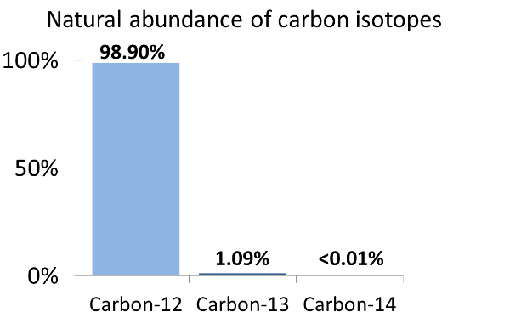
Carbon is the sixth most abundant element in the universe.
This graph shows approximately how much of each isotope of carbon makes up all the carbon found in nature. About 98.9% of all carbon is the carbon-12 isotope.
This means that if you took 10,000 carbon atoms from nature, approximately 9,890 would be the carbon-12 isotope, 109 would be the carbon-13 isotope, and 1 would be the carbon-14 isotope.

Slide 14
You may have noticed that on the periodic table the atomic mass of carbon is shown as 12.011.
The mass number is the number of protons plus neutrons in the nucleus, but we cannot have 0.011 of a proton or neutron!
The number shown on the periodic table is known as the relative atomic mass and is an average mass of all isotopes of carbon based on how abundant they are in nature. Since carbon-12 makes up 98.9% of all carbon found in nature, the relative atomic mass of carbon is very close to 12.

